Slide 1


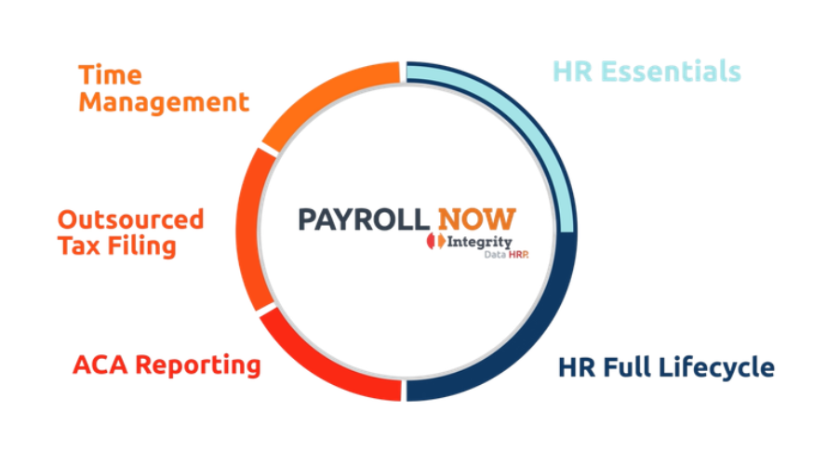
A complete payroll and HR ecosystem built natively for Microsoft Dynamics 365 Business Central.
With Payroll NOW
at the core, the
HRP tech stack
expands to cover
every stage of the
employee
lifecycle, from
hire to retire

